Slide 1

Google Analytics case study
How Does a Bike-Share Navigate Speedy Success?

Slide 2
About the company In 2016, Cyclistic launched a successful bike-share offering. Since then, the program has grown to a fleet of 5,824 bicycles that are geotracked and locked into a network of 692 stations across Chicago. The bikes can be unlocked from one station and returned to any other station in the system anytime.
Data use for this analysis is from January 2022 to December 2022
https://divvy-tripdata.s3.amazonaws.com/index.html

Slide 3
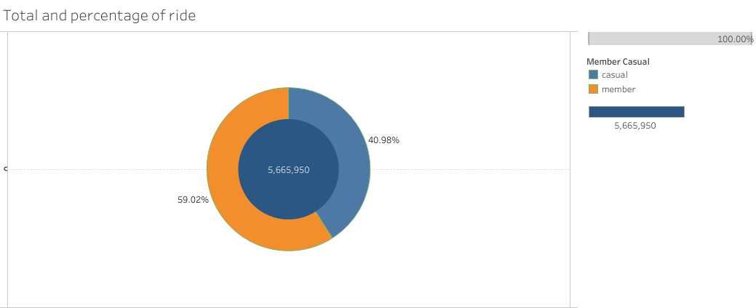
Member Riders: Members account for approximately 59.02% of total rides.
Casual Riders: Casual riders make up about 40.98% of total rides.
This insight highlights the composition of your rider base, indicating that a significant majority of rides are taken by members. This information can be used to inform strategies related to member retention, casual rider conversion, and marketing efforts tailored to each group.

Slide 4
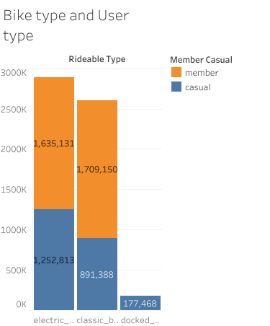
Trends and Insights:
Popular Rideable Types Among Members:
"Classic bike" and "electric bike" are the preferred rideable types among members.
"Classic bike" has the highest count of member riders, followed by "electric bike."
Casual Rider Preferences:
Among casual riders, "electric bike" is the most popular, followed by "classic bike," while "docked bike" has the lowest count of casual riders.

Slide 5
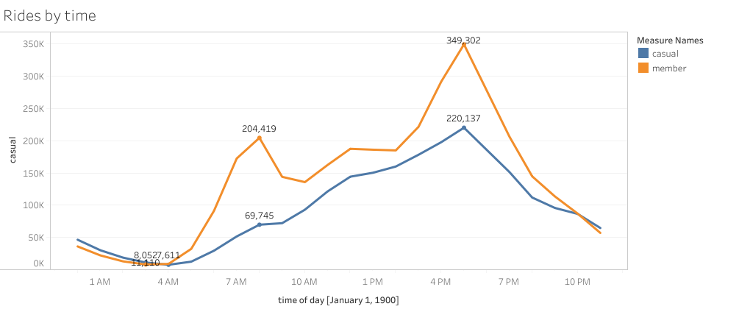
Trends and Insights:
Hourly Ridership Patterns:
Ridership for both casual and member riders varies throughout the day.
Casual ridership tends to peak in the late afternoon, around 5 PM, and gradually decreases thereafter.
Member ridership shows a more consistent pattern with higher numbers during around 8 AM and 5PM and lower numbers during the night.

Slide 6
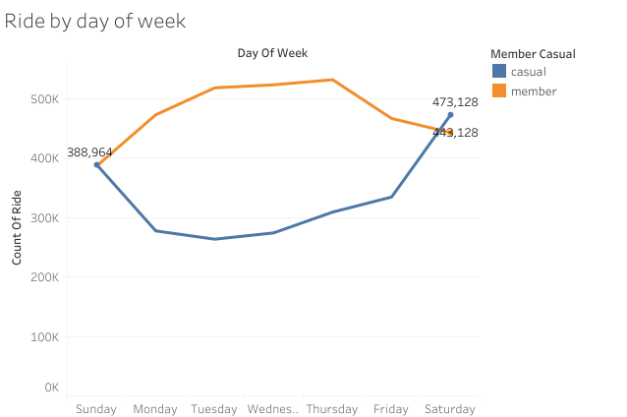
Trends and Insights:
Day of the Week Trends:
Members tend to ride more frequently during the weekdays (Monday to Friday).
As tend to use as daily commuters
Casual ridership is highest on Saturday, followed closely by Sunday.
Weekend Patterns:
Both members and casual riders show a notable increase in ridership on the weekends (Saturday and Sunday). This suggests that weekends are popular for biking activities

Slide 7
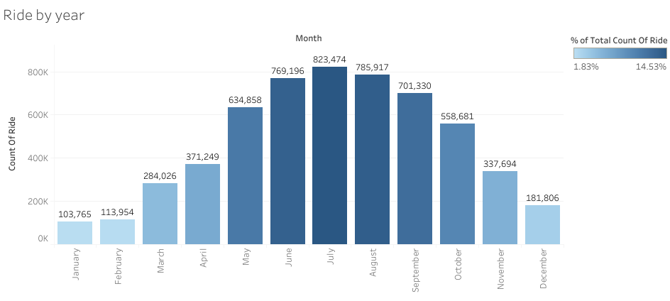
Trends and Insights:
Ridership is highest during the summer months, with July the average of 14.53% and August having the highest percentages of total rides
Ridership generally decreases as the year progresses, with a notable decline from September onwards.
The lowest ridership is observed in January with 1.83% and February, likely due to colder weather.

Slide 8
Conclusions
Seasonal Variations: There are clear seasonal variations in ridership, with the summer months being the peak season for riding and the winter months experiencing lower ridership. This suggests that the marketing and operational strategies should be adapted to account for these seasonal fluctuations.
Rideable Type Preferences: Understanding the popularity of rideable types among members is crucial. "Classic bike" and "electric bike" are preferred by members, which can inform inventory and marketing decisions.
Hourly Ridership: There are variations in ridership throughout the day, indicating opportunities to optimize bike availability, staffing, and promotions during peak hours.

Slide 9
Recommendations:
Promote membership benefits tailored to the preferred rideable types of members.
Implement targeted promotions during peak ridership hours to convert casual riders into members.
Offer seasonal membership promotions to capitalize on high ridership months.
Consider referral programs and tiered membership benefits to incentivize conversion.
Host member-exclusive events to showcase the advantages of membership.
Create educational content to communicate the long-term benefits of membership.
Continuously gather feedback and make improvements to the sign-up process.

Slide 10
Thank you

